Slide 1
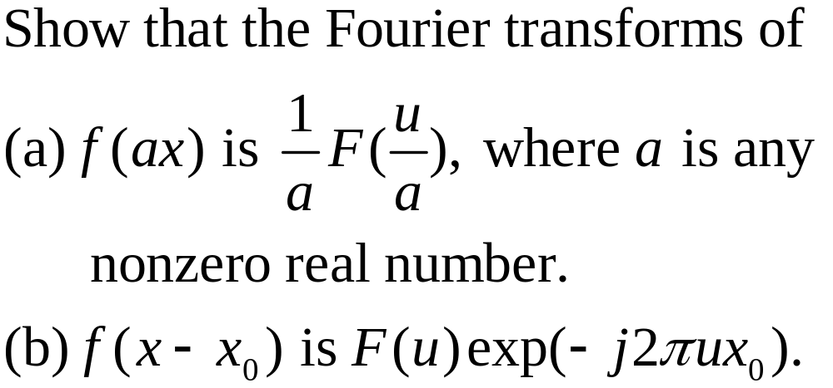
Homework 8 (Due: 4/13)

